Slide 1

FEATURE ENGINEERING

Slide 2
Weight in grams
1200
1000
Year of experience
5
10
Data Squad | Intro to AI

Slide 3

FEATURE SCALING
The process of processing numerical features and converting them into a uniform scale is known as feature scaling
whilst some algorithms are virtually invariant to this technique, for other it is determinent
Data Squad | Intro to AI

Slide 4
FEATURE SCALING - WHY IS IT IMPORTANT?
Weight in grams
Which point is closer from a KNN perspective?
1200
1000
Year of experience
5
10
Data Squad | Intro to AI

Slide 5
FEATURE SCALING - WHY IS IT IMPORTANT?
Weight in grams
1200
Crucial in distance based algorithms
20%
1000
Year of experience
5
100%
10
Data Squad | Intro to AI

Slide 6
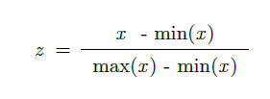
NORMALIZATION
EACH VALUE OF THE DATASET X WILL BE CONVERTED TO A NEW "NORMALIZED" VALUE Z
SHAPE OF THE DISTRIBUTION OF DATA IS UNCHANGED
Data Squad | Intro to AI

Slide 7
NORMALIZATION
RE-SCALE THE DISTRIBUTION TO BE BETWEEN ZERO AND ONE!
EACH VALUE OF THE DATASET X WILL BE CONVERTED TO A NEW "NORMALIZED" VALUE Z
SHAPE OF THE DISTRIBUTION OF DATA IS UNCHANGED
Data Squad | Intro to AI

Slide 8

Z-SCORE : STANDARDIZATION
THE Z-SCORE IS A WAY TO STANDARDIZE/NORMALIZE ALL YOUR DATA IN A WAY THAT TELLS YOU HOW MANY STANDARD DEVIATIONS EACH POINT IS FROM THE MEAN
IF THE Z-SCORE IS LESS THAN 1: THAT DATA POINT IS WITHIN 1 STANDARD DEVIATION OF MEAN
ALLOWS YOU TO BRING DIFFERENT DISTRIBUTIONS TO THE SAME SCALE
EXAMPLE OF USAGE: TO STANDARDIZE GRADES ACROSS DIFFERENT SCHOOLS
VERY IMPORTANT IN MACHINE LEARNING
Data Squad | Intro to AI

Slide 9
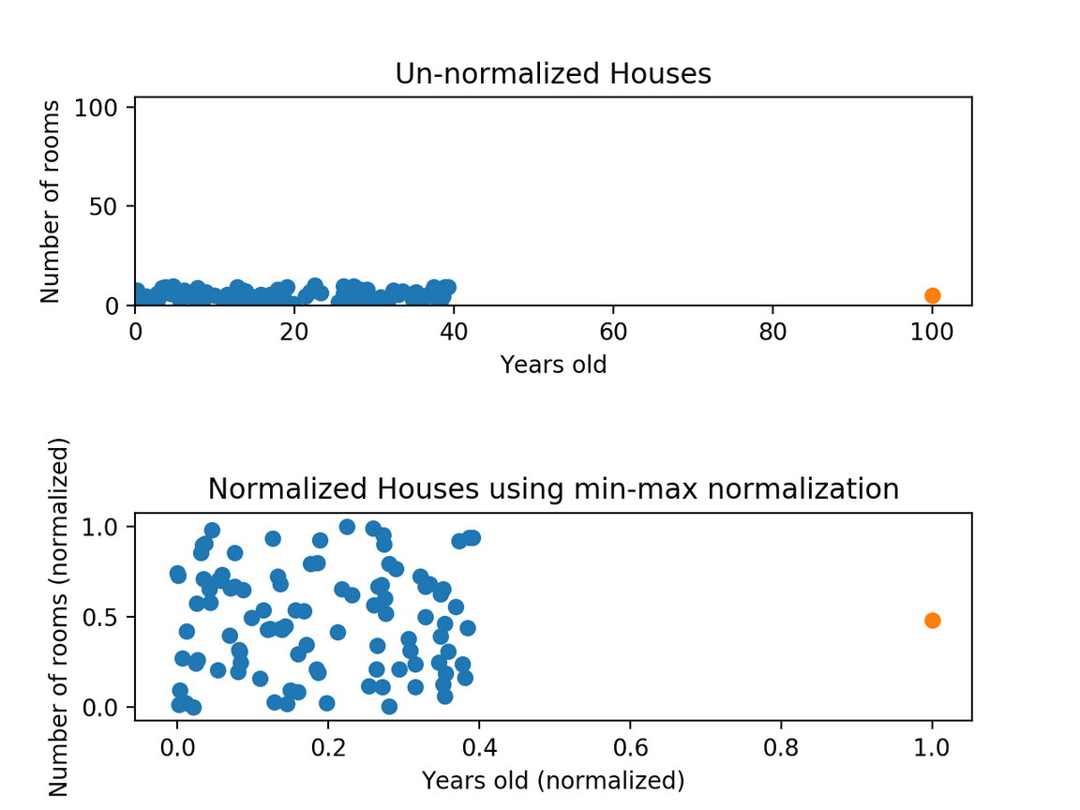
BEFORE AND AFTER FEATURE SCALING
Data Squad | Intro to AI

Slide 10
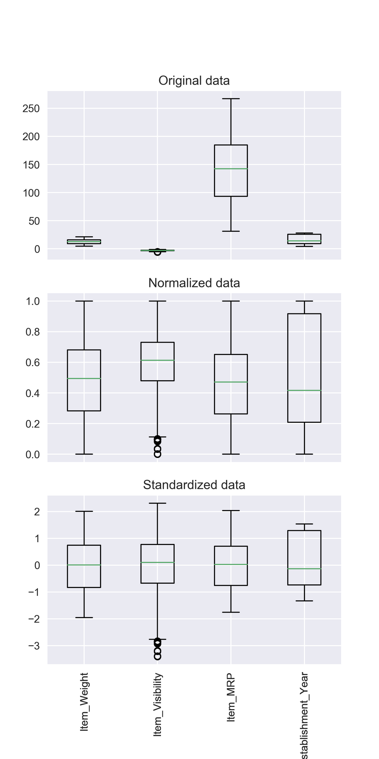
Data Squad | Intro to AI

Slide 11
FEATURE SELECTION - NUMERICAL VS CATEGORICAL
The techniques used to handle numerical and categorical variables in preparing a dataset for machine learning, are quite different
Numerical Features are usually used by the algorithms to quantify "distances" between different data points
On the other hand, we cannot define such distances for categorical variables
If a feature is the colour of an object, how "different" red from blue?
how about red from green?
Data Squad | Intro to AI

Slide 12
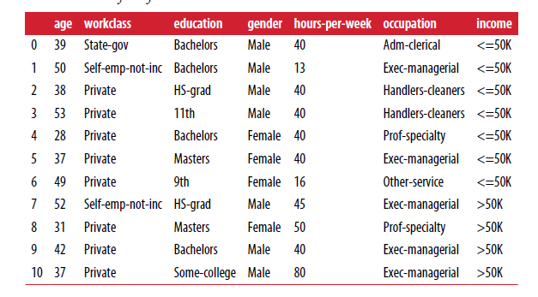
FEATURE SELECTION - ONE HOT ENCODING
One hot encoding: replace a categorical variable with one of more new features that have the values of 0 or 1.
What are the consequences of this technique in terms of the cardinality of the variable?
Data Squad | Intro to AI

Slide 13
FEATURE SELECTION - ONE HOT ENCODING
One hot encoding: replace a categorical variable with one of more new features that have the values of 0 or 1.
What are the consequences of this technique in terms of the cardinality of the variable?
Data Squad | Intro to AI

Slide 14

FEATURE SELECTION - ONE HOT ENCODING
One hot encoding for the working class column
Watch out that numbers can encode categorical variables
Data Squad | Intro to AI

Slide 15
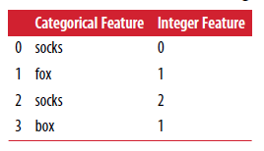
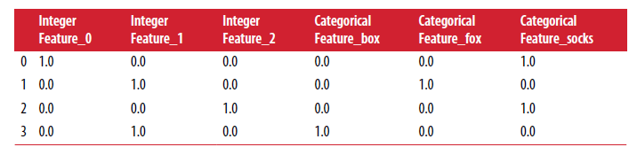
FEATURE SELECTION - ONE HOT ENCODING
Watch out that numbers can encode categorical variables
Data Squad | Intro to AI

Slide 16
FEATURE SELECTION - BINNING
Create groups of lower granularity from elements of a variable
Also known as descritization when applied to numerical variables
In Python can be done with cut and qcut
Data Squad | Intro to AI

Slide 17

FEATURE SELECTION - TESTS OF INDEPENDENCE
Remember Module 2 techniques:
- Chi-Squared goodness of fit tests of contingency
- 2-sample t-tests (and ANOVA tests) to see if you can perform further aggregations
Data Squad | Intro to AI

Slide 18
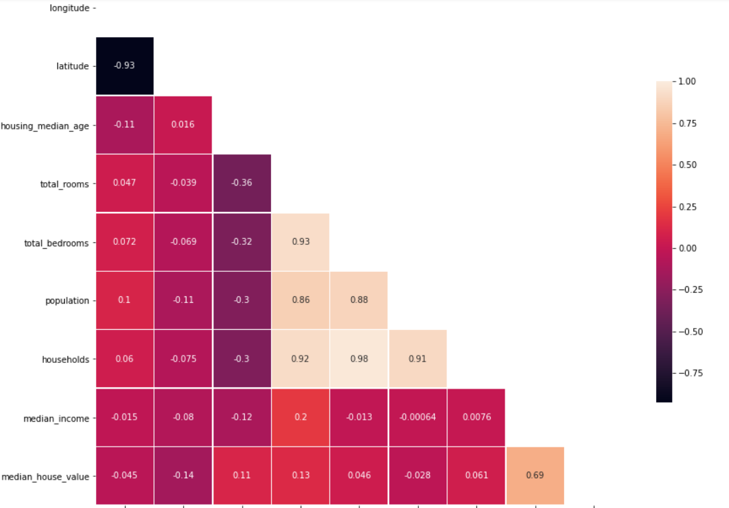
CORRELATION THRESHOLDS
DEEP RELATION WITH THE CONCEPT OF MUTUAL INFORMATION
THE BEST NUMERICAL FEATURES ARE THOSE WITH A HIGH EXPLANATORY POWER OF THE TARGET VARIABLE, BUT LOW MUTUAL INFORMATION AMONGST THEMSELVES
CORRELATION THRESHOLDS ALLOW US CREATE THE ABOVE CRITERIA AND THUS FILTER OUT REDUNDANT VARIABLES
Data Squad | Intro to AI

Slide 19
ANY QUESTIONS ?

Slide 20
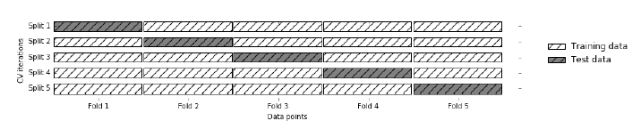
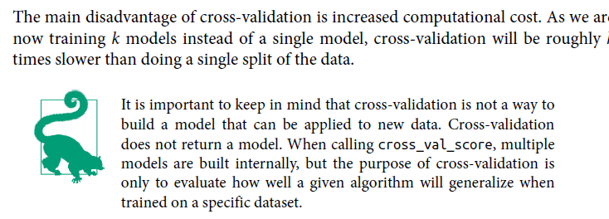
MODEL GENERALIZATION
Data Squad | Intro to AI

Slide 21
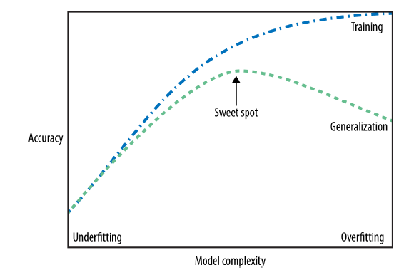
GENERALIZATION, UNDERFITTING & OVERFITTING
Data Squad | Intro to AI

